Slide 1

College Query
The App for parents
Don’t just send them to College…
Send them AWAY To College!
A 3DP Product
(Daniel, Dave, Don & Pei)

Slide 2

Product Features
Query the Massive U.S. Department of Education Database
Search all Colleges and Universities in the U.S.
Search by Major / Program of Study
Filter Results by Geographic Region
Connect Directly to College Web Sites

Slide 3
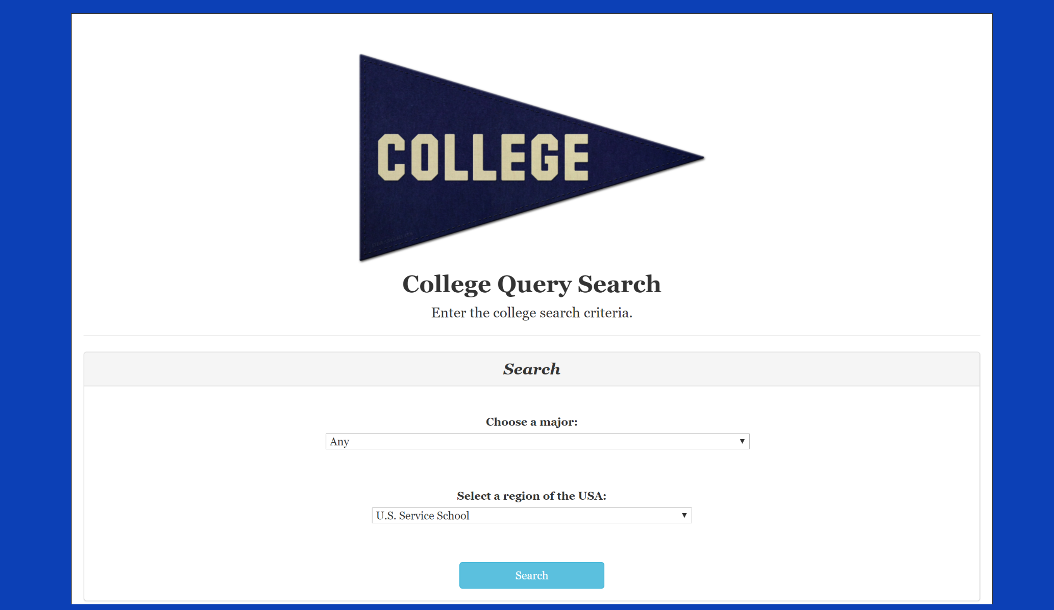
Front End

Slide 4
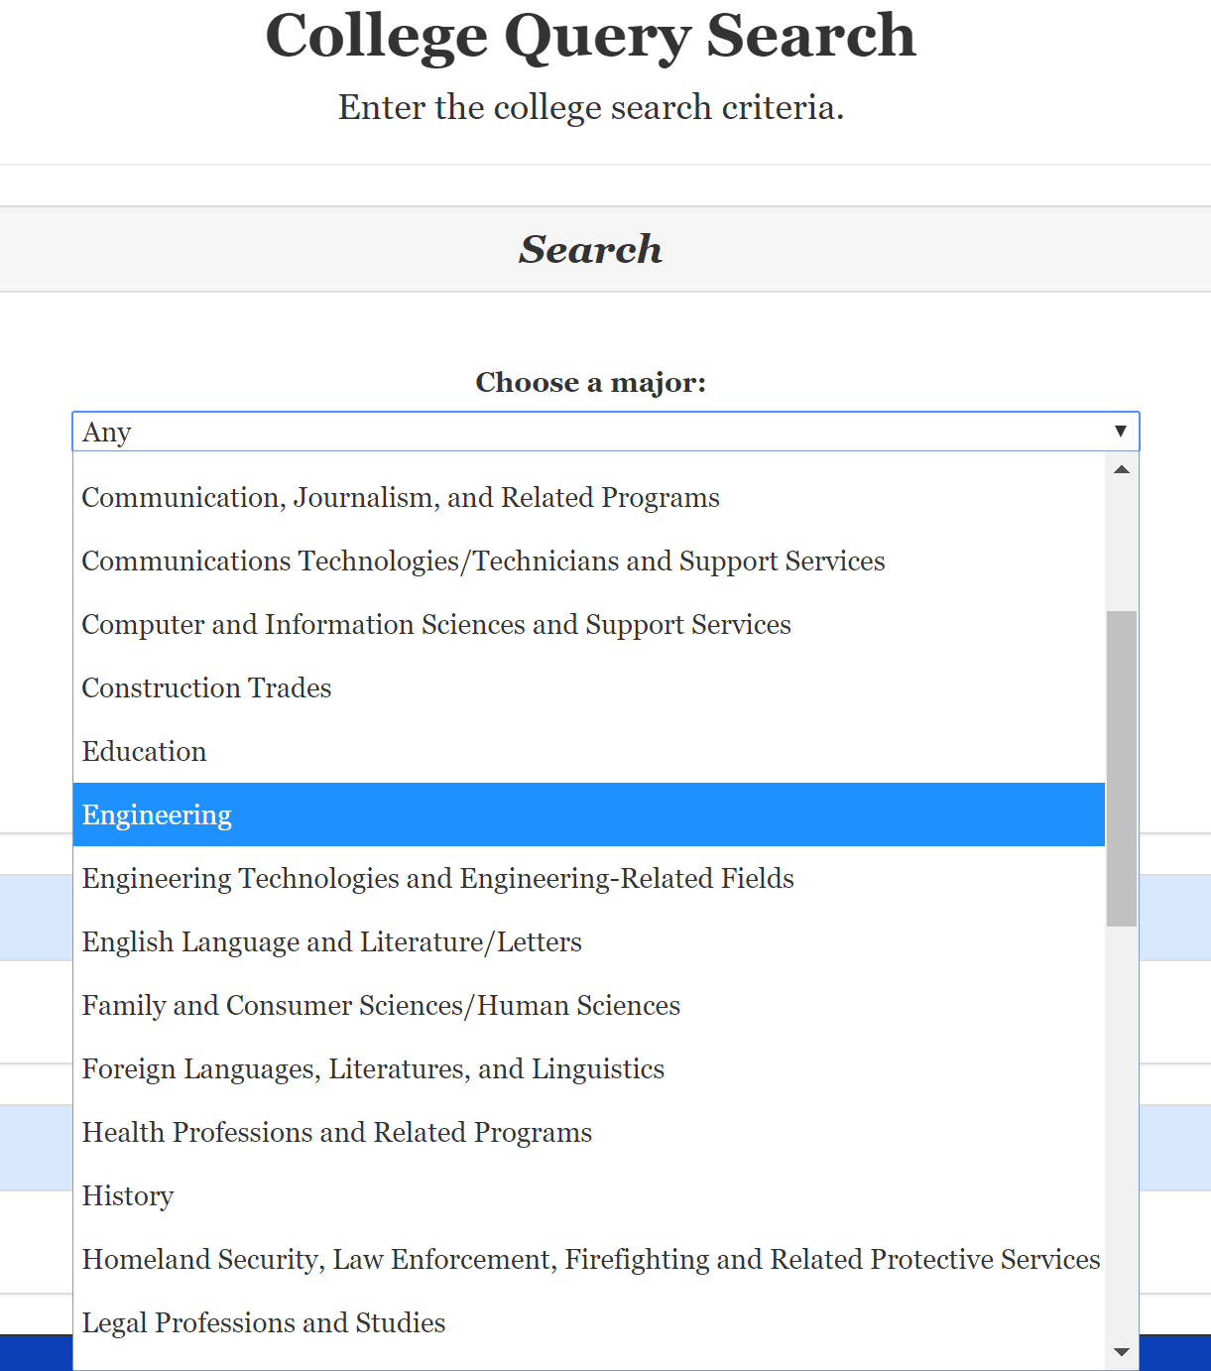
Search by Major / Program of Study

Slide 5
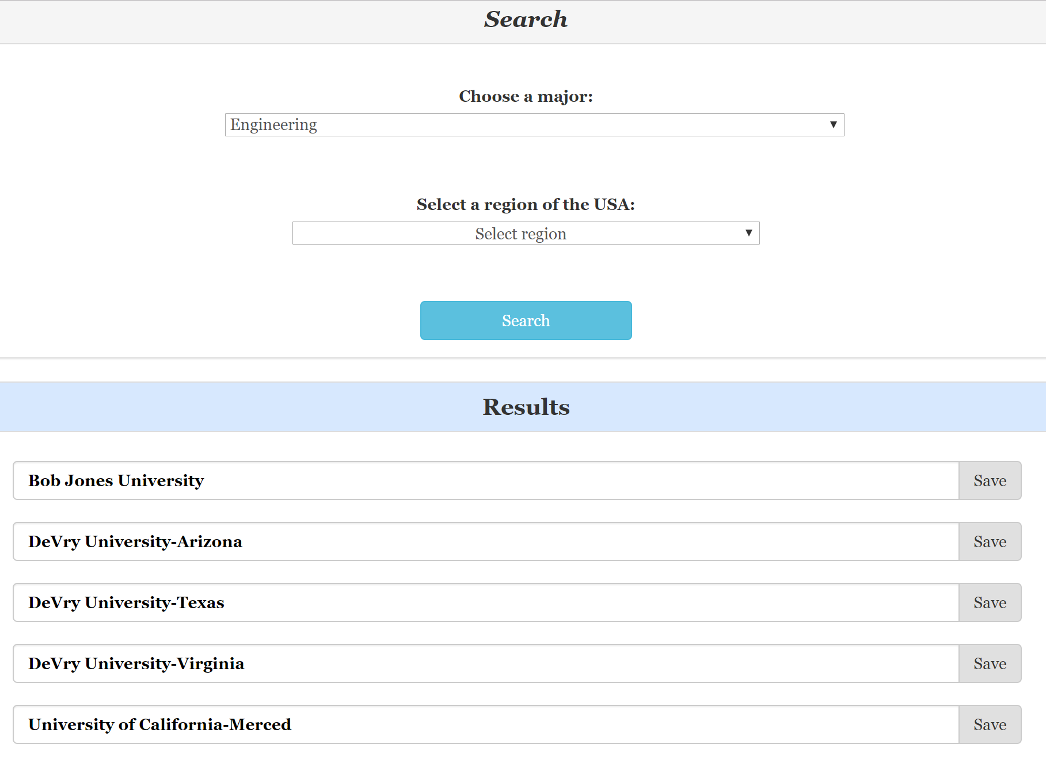
View Results

Slide 6
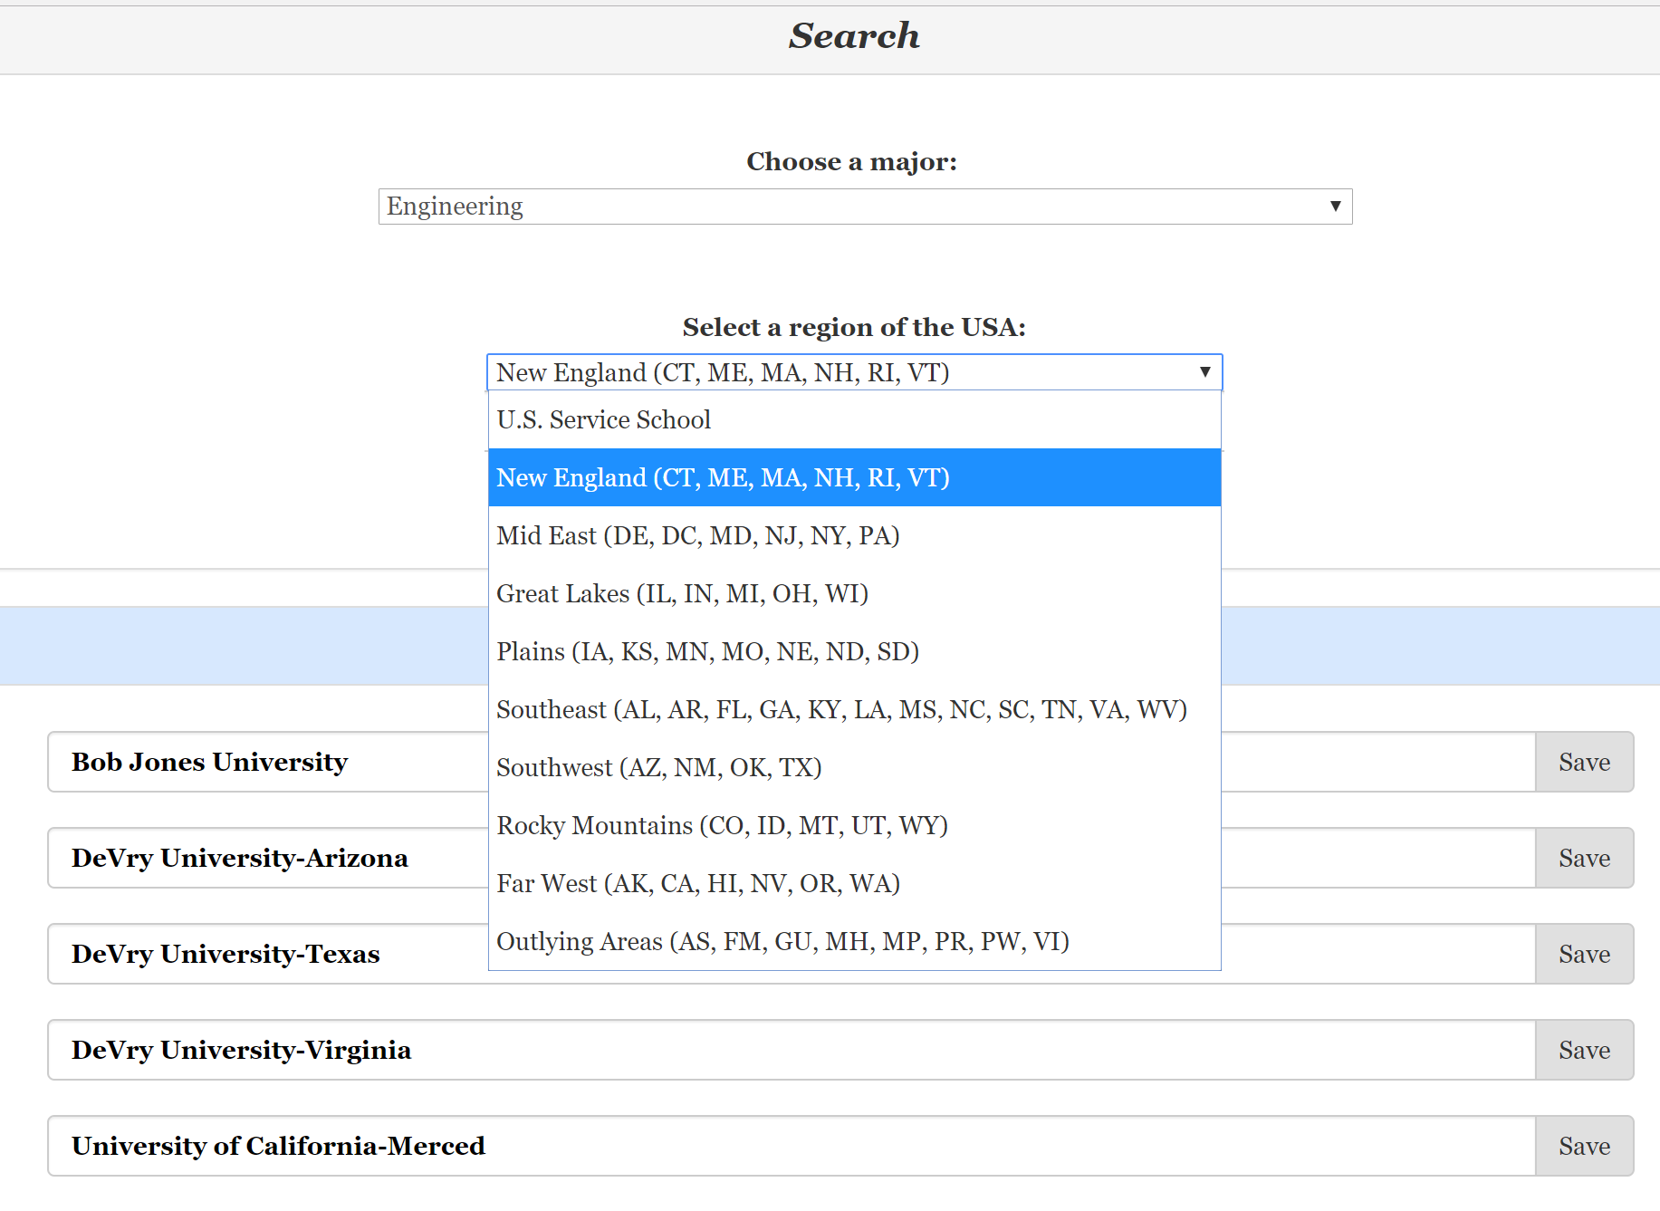
Filter Results by Geographic Region

Slide 7
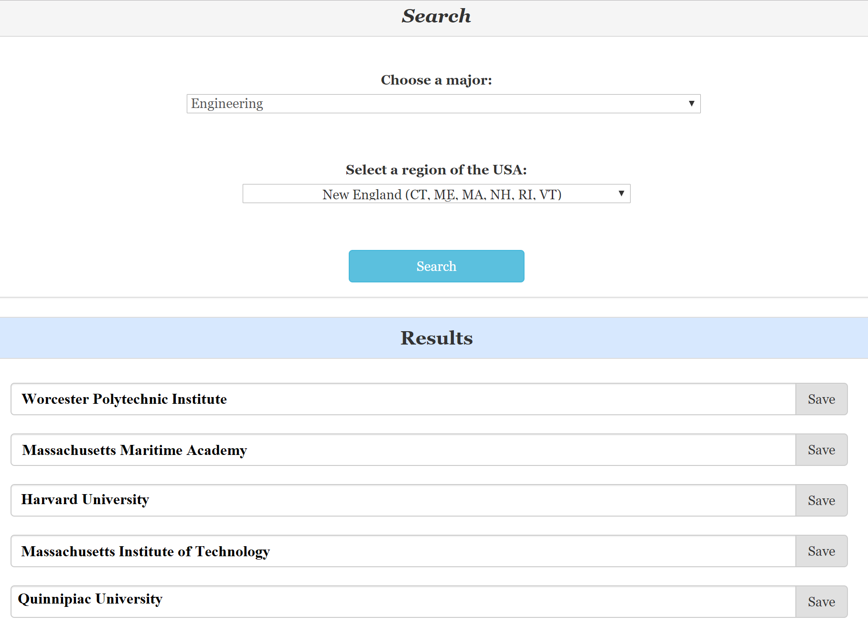
Results Update Instantly!

Slide 8
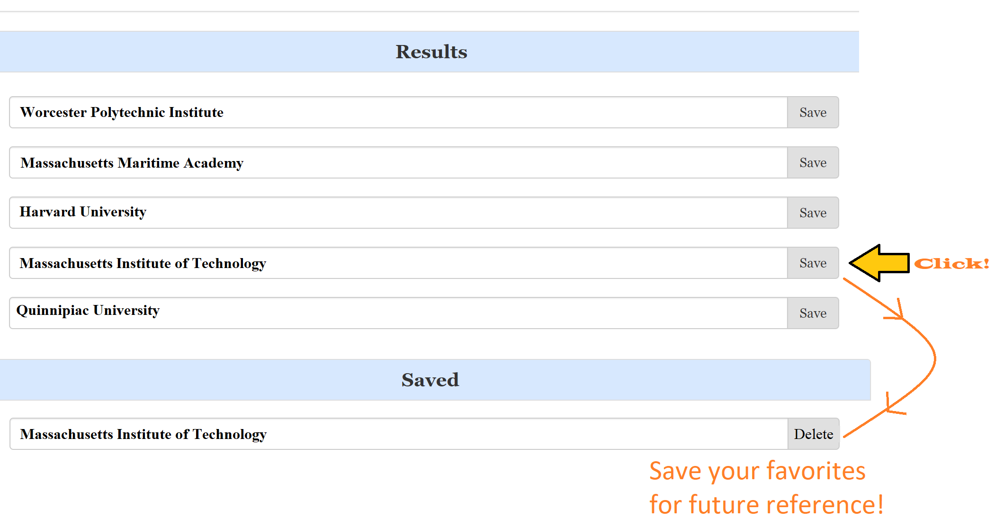
Save Your Favorites

Slide 9
Save Your Favorites

Slide 10
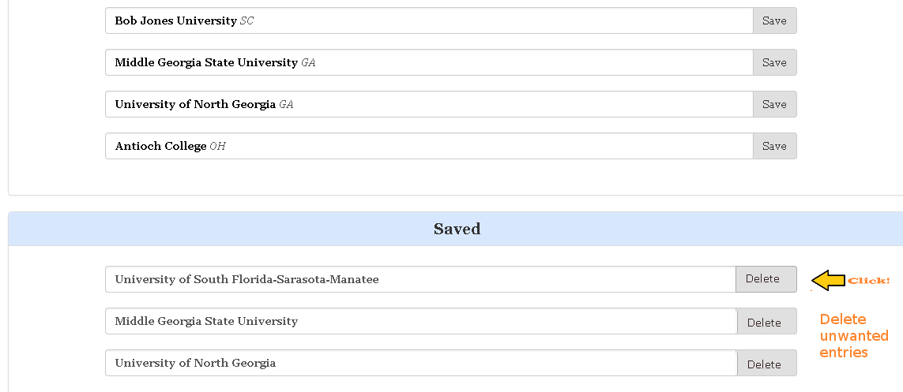
Delete Saved Schools You No Longer Need

Slide 11
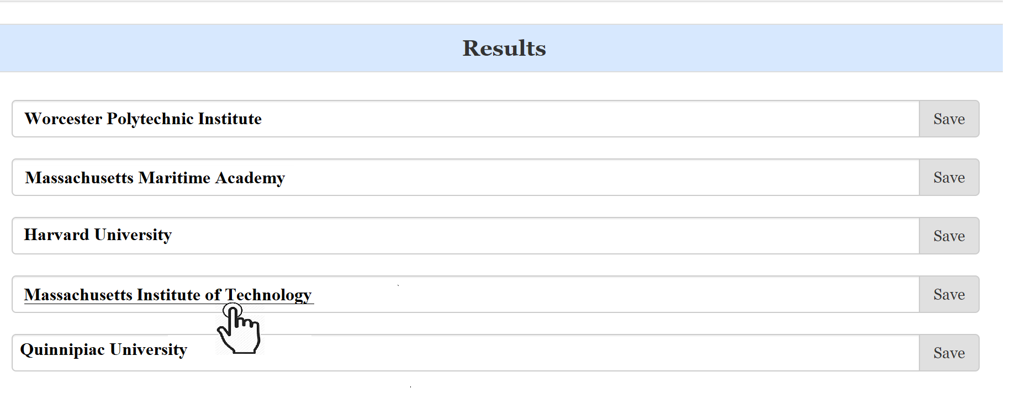
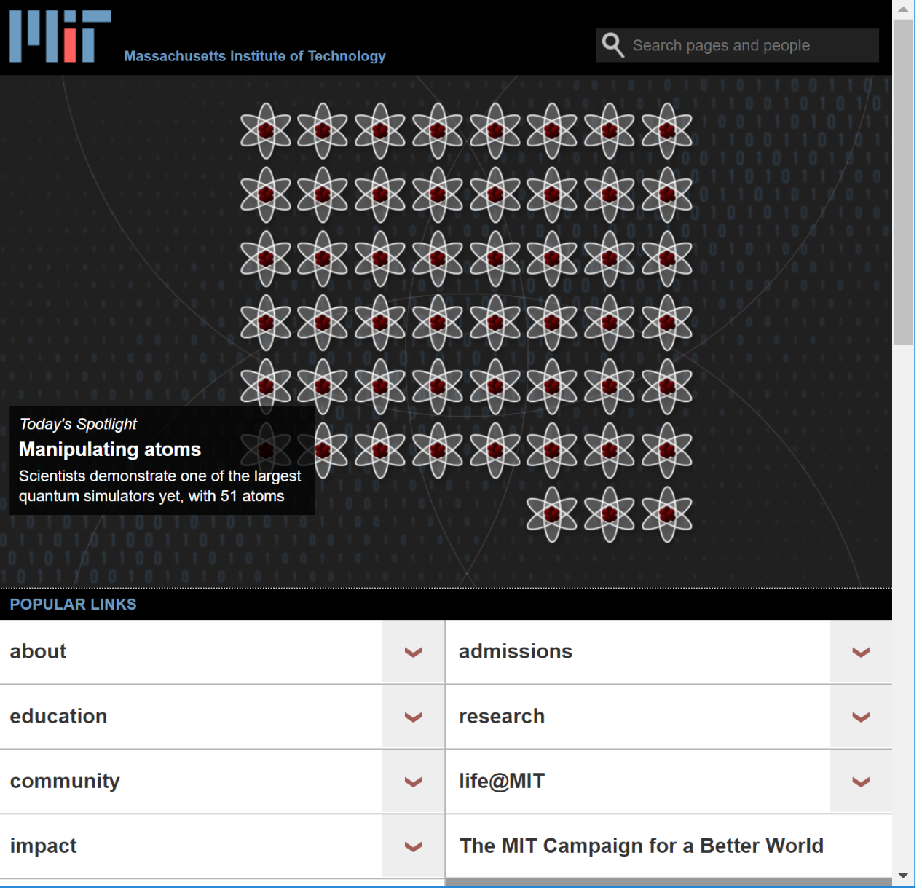
Active URLs to All College Web Sites

Slide 12
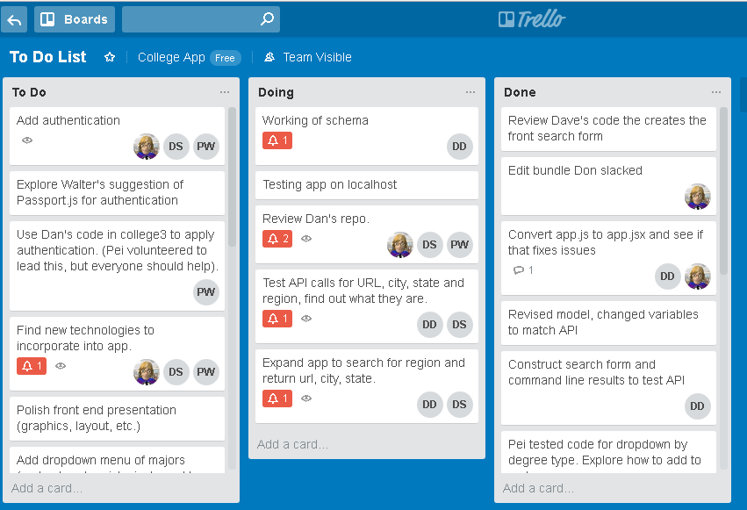
How We Worked
Project management with Trello:

Slide 13
Build Captain: Daniel Day
- Maintained source repo
- Merged changes
- Tested base level build
Pei & Don: Search and Save results, DB
Dave & Dan: Query search functionality, API
All: Testing and bug fixes

Slide 14
Technologies
The MERN Stack:
- MongoDB as the NoSQL database
- Express web framework of Node.js
- React.js creates the frontend
- Node.js server platform
And... Webpack: A module bundler to assemble JavaScript files for usage in a browser

Slide 15
Project File Structure
/app app.js
/components
/children
Main.jsx
Query.jsx
Search.jsx
Save.jsx
/utils helpers.js
/controllers controller.js
/models
College.js
/public
/img bundle.js index.html server.js package.json package-lock.json webpack.config.js

Slide 16
Future Enhancements
Authentication using Passport – We experiemented with it outside the app with some success, ran out of time to implement
Additional search features:
- Select 2 or 4 year degree
- Display satellite campuses
- Add a url to a price calculator with data from the API

Slide 17
Retrospective
What went well:
- Good communication; everybody on the same page with Trello
- Team members eager to help other's out
- Four heads are better than one when solving problems!
- Excellent resources, esp. CollegeScoreCare data dictionary that explained the API
Challenges:
- Complexity! Getting things to work wasn't always easy with so many moving pieces
- Multiple code changes at once; needed to retreat and test one change at a time

